Slide 1


ECEN 404 Final Presentation Microservices Management Elizabeth Weichel Souryendu Das Dr. Shakkottai

Slide 2
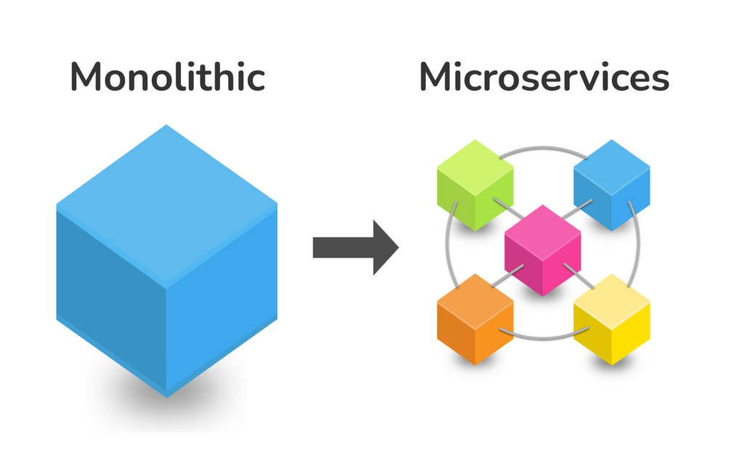
Problem Overview
- Microservices are becoming increasingly common
- How can we effectively and autonomously scale these?
https://www.krasamo.com/microservices-architecture-for-real-world-business-needs/

Slide 3
Integrated Project Diagram
Basic: Sequential Scaling
Better: Cost Model
Best: Structured Approach
Abbreviation: Microservice=MS

Slide 4
Integrated Project Diagram
Basic: Sequential Scaling
- Written in python to explore the simulator and control OpenAI gym
- Presented during project update 2

Slide 5
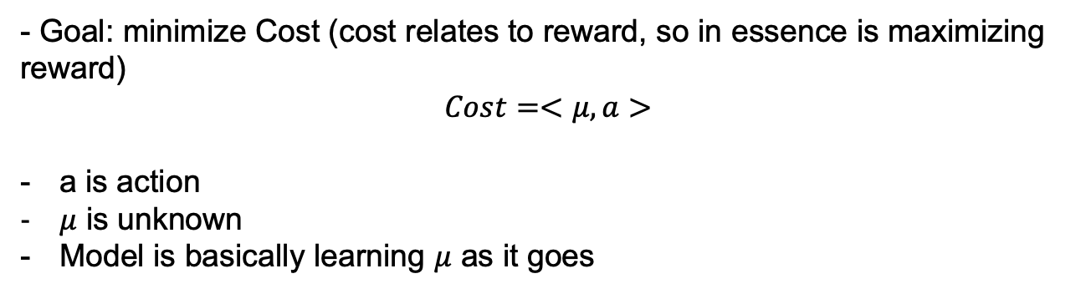
Integrated Project Diagram
Better: Cost Model (Bandit)
- Goal: minimize Cost (cost relates to reward, so in essence is maximizing reward)
$$Cost=<μ,a>$$
a is action
$μ$ is unknown
Model is basically learning $μ$ as it goes

Slide 6
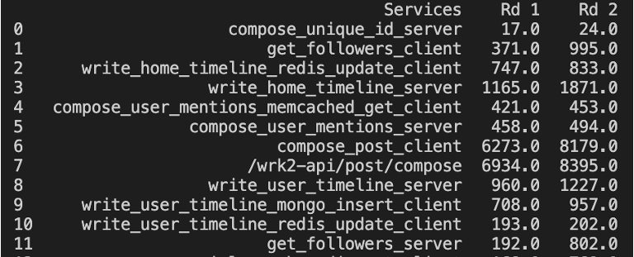
Integrated Project Diagram
Best: Structured Approach
Get ready for math!
As verified by my work with Jaeger traces, MS behave like queues

Slide 7
Integrated Project Diagram
Best: Structured Approach
As verified by my work with Jaeger traces, MS behave like queues
delay
Jobs
Server
delay function: f(a)
a ->

Slide 8
Integrated Project Diagram
Best: Structured Approach
f₁(a₁)
f₂(a₂)
f₃(a₃)
f₄(a₄)
Job
Job
Now: f(a) = f₁(a₁) + f₂(a₂) + f₂(a₂) + f₂(a₂)
With the goal being to minimize f(a) (total delay)

Slide 9
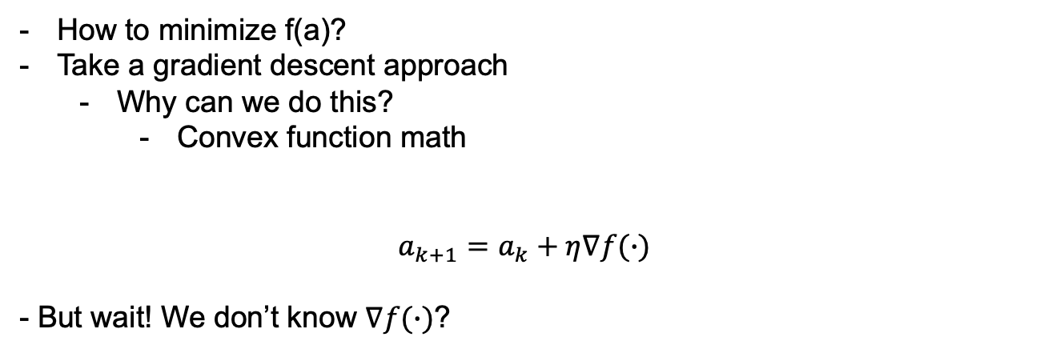
Integrated Project Diagram
Best: Structured Approach
How to minimize f(a)?
Take a gradient descent approach
Why can we do this?
Convex function math
$$a_{k+1}=a_{k}+η∇f(∙)$$
- But wait! We don’t know $∇f(∙)$?

Slide 10
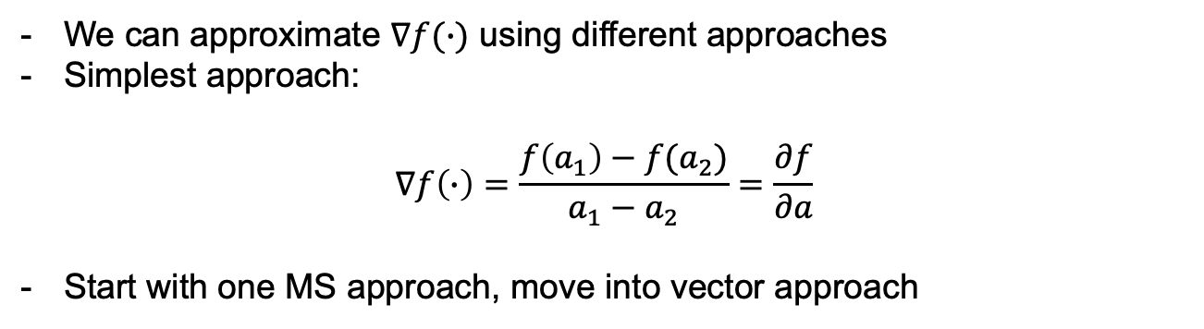
Integrated Project Diagram
Best: Structured Approach
We can approximate $∇f(∙)$ using different approaches
Simplest approach:
$$∇f\left(∙\right)=\frac{f\left(a_{1}\right)−f(a_{2})}{a_{1}−a_{2}}=\frac{∂f}{∂a}$$
Start with one MS approach, move into vector approach

Slide 11
Integrated Project Diagram
Best: Structured Approach
Making decisions based off solely latency

Slide 12
Engineering Design Accomplishments
Sequential Scaling as presented to test simulator
Container-level latencies from Jaeger
Gradient descent 1 MS implemented

Slide 13
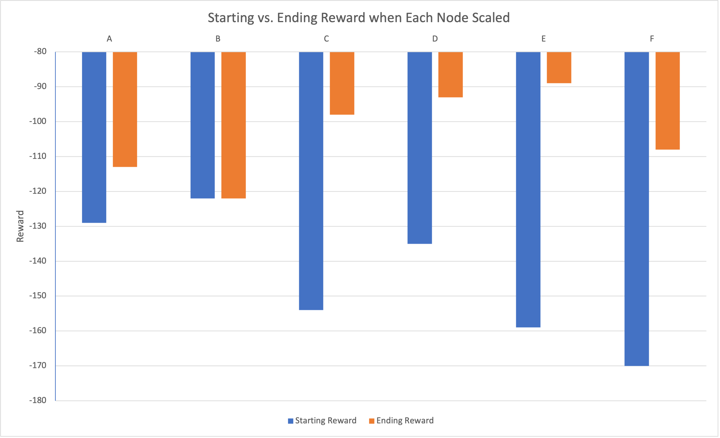
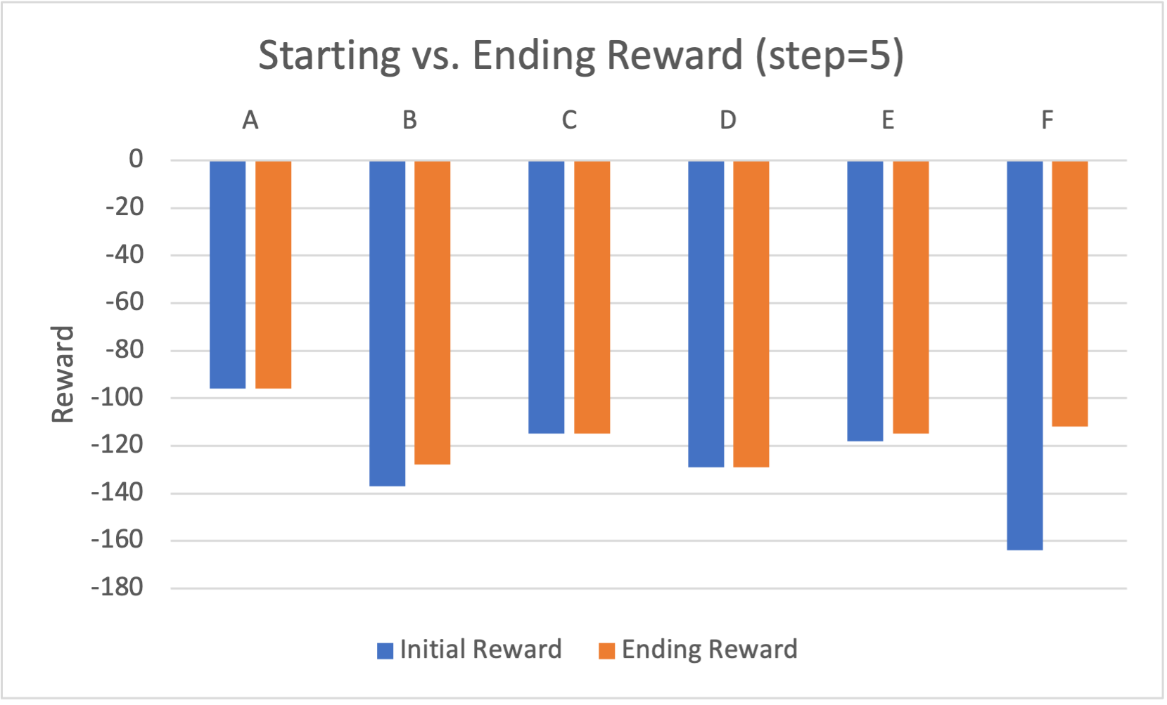
Integrated System Results
Sequential Scaling

Slide 14
Integrated System Results
Best: Structured Approach (Reward Based)
Encountered one key problem that was interesting to solve.
Allocation | Reward | Latency
3.1 | -1.265
0.61968 | -3.351 | 3.227
0.12661 | -15.822 | 15.7966
5.24823 | -1.43 | 0.381
7.31 | -1.7357 | 0.2735
10.935988 | -2.37 | 0.18288
Didn’t decrease resources

Slide 15

Integrated System Results
Best: Structured Approach (Reward Based)
Encountered one key problem that was interesting to solve.
$$a_{k+1}=a_{k}+η∇f(∙)$$
$$∇f\left(∙\right)=\frac{f\left(a_{1}\right)−f(a_{2})}{a_{1}−a_{2}}=\frac{∂f}{∂a}$$
If allocation is large enough, the gradient term will not outweigh the allocation and the action will stay positive ultimately pushing the algo towards infinite allocation

Slide 16
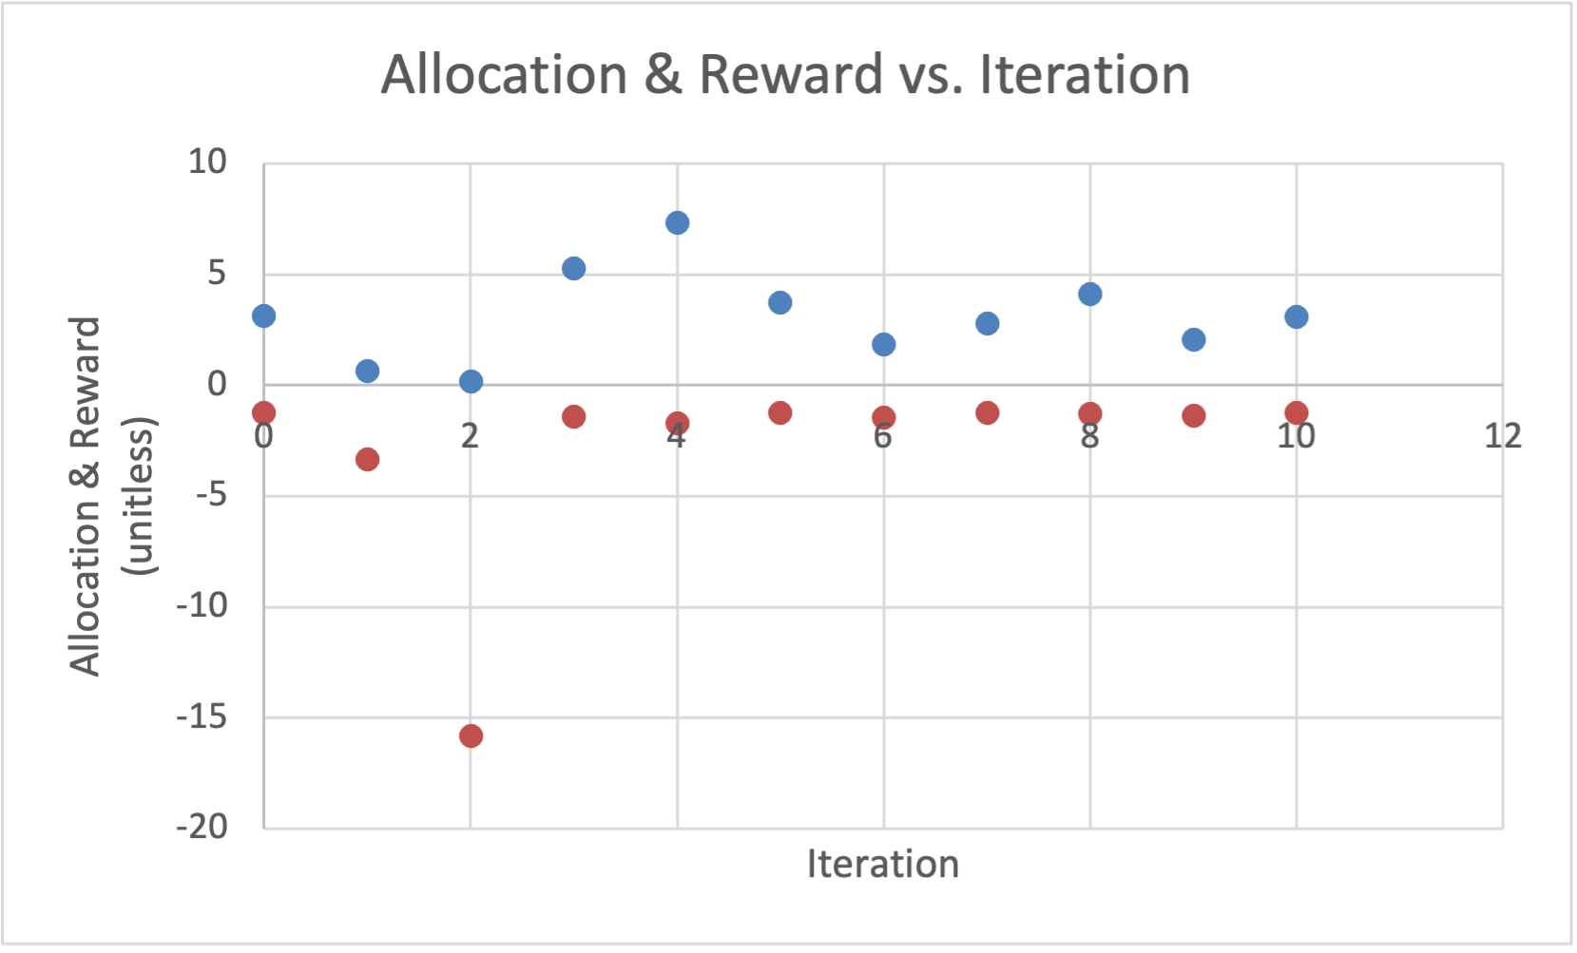
Integrated System Results
Best: Structured Approach
Red: Allocation
Blue: Reward
One microservice approach. Working on extending this to multiple microservices (vectors) before demo

Slide 17
Integrated System Results
Best: Structured Approach
More data. MS began w/ 5 resources

Slide 18
Conclusions
Exciting to be moving into the gradient descent/online convex optimization path
Current status: 1 MS approach implemented
Next: extend to multiple MS, clean up code

Slide 19
Questions?

